Slide 1
Evaluation of Embedded Hardware and Cone Detection
Project 4 – AMS Lab Project
Supervisors: Prof. Benjamin Noack, Moritz Pötzsch Team Members: Abhishek Pannase, Sandipan Seal, Rizwan Mohsin
31.03.2025

Slide 2
Introduction
Autonomous navigation can be beneficial for racing cars to detect the cones on the track precisely
Accurate detection ensures smooth path planning and better performance
CPU-based processing is slow for real-time applications
Previous implementations used only FPGA- CPU-based processing
Abhishek
2
Notes:
2

Slide 3
Objectives
Our goal is to optimize and explore cone detection by leveraging GPU-based processing
Enhance performance and offload the CPU
Compare execution speeds on different platforms (local CPU, local GPU, onboard CPU) to assess efficiency.
Abhishek
3
Notes:
3

Slide 4
Hardware and Software
Hardware:
AMD Kria Board
The AMD Kria board is a System-on-Module (SoM)
Zynq® UltraScale+™ MPSoC featuring a quad-core Arm® Cortex®-A53 processor (up to 1.5 GHz)
Dual-core Arm Cortex-R5F real-time processor (up to 600 MHz), and a Mali™-400 MP2 GPU (up to 667 MHz)
4 GB of 64-bit DDR4 memory and 16 GB of eMMC storage
Local Machine
Intel(R) Core(TM) i5-7300HQ CPU @ 2.50GHz 2.50 GHz
NVIDIA GeForce GTX 1050 Mobile - 2048 MB VRAM
16.0 GB of 64-bit DDR4 memory
Software: OpenCV (v 4.11.0), OpenCL (v 2.0), Python (v 3.12)
Tools: Visual Studio Code
Abhishek
4

Slide 5
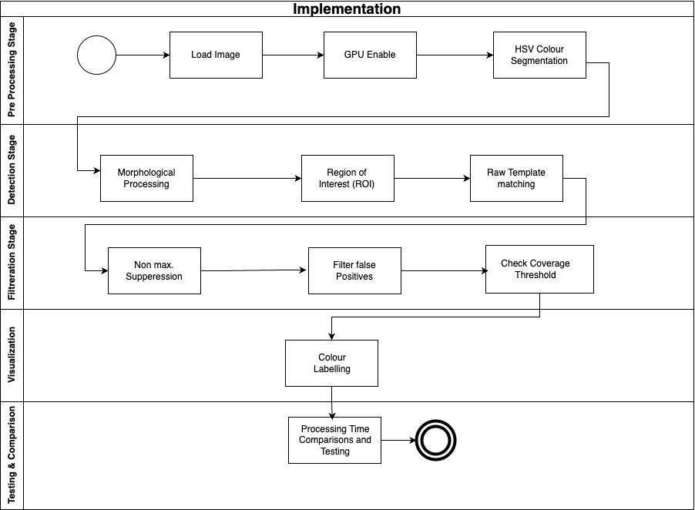
Implementation Workflow
Abhishek
5

Slide 6
Implementation Methodologies
Load Image & Template: Reads the input image and cone template. We use cv.imread() to read the main image and cone template
GPU/CPU Selection: Uses OpenCL (GPU) if enabled, else processes on CPU. If GPU is enabled, we convert images to cv.UMat for OpenCL.
HSV Segmentation: Convert the image from BGR → HSV using cv.cvtColor(). Use cv.inRange() to create a binary mask.
Morphological Processing: Cleans the mask . Small noise is removed using morphological opening/closing operations. Opening removes small dots. Closing fills small gaps inside cones.
Abhishek
6

Slide 7
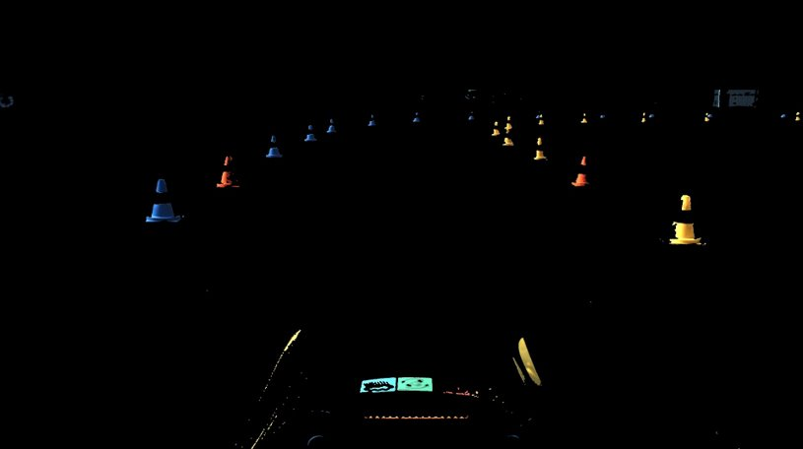
Implementation Methodologies
Region of Interest (ROI): Focus processing on the relevant image area (usually the lower 80% where cones are expected).
Sandipan
7

Slide 8
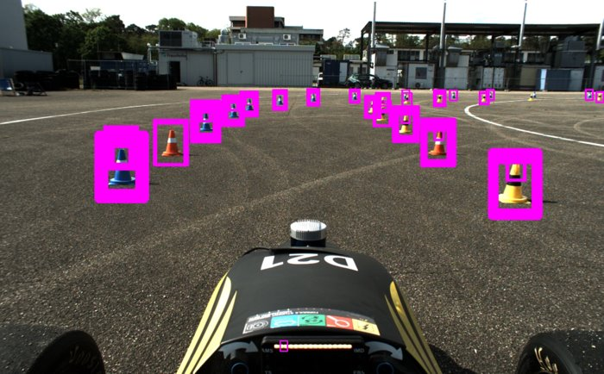
Implementation Methodologies
Raw Template matching:
The cone template is resized over multiple scales and matched against the segmented ROI
Detections above a set threshold are recorded.( No. Of Cones = 7114 )
Sandipan
8

Slide 9
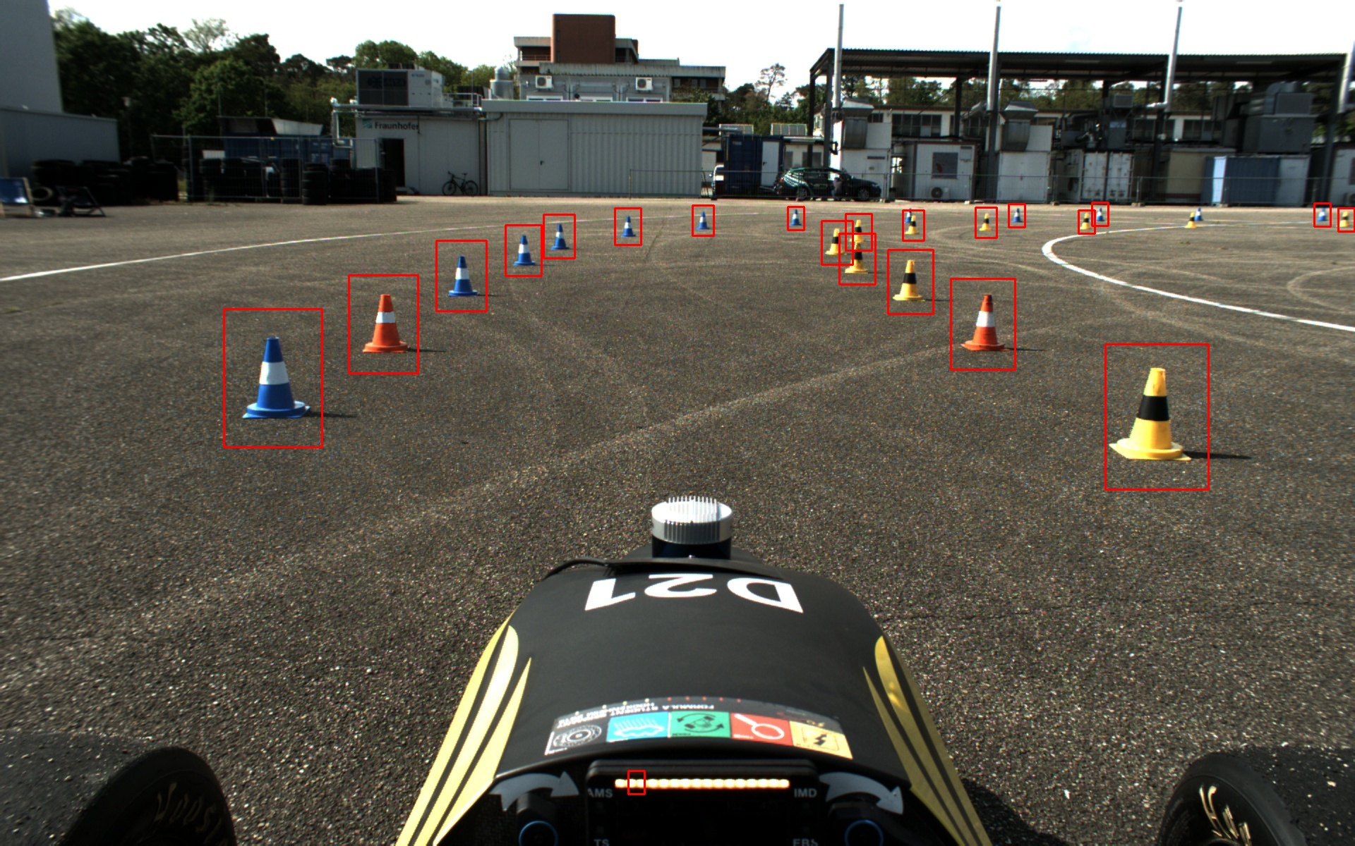
Implementation Methodologies
Non-Maximum Suppression (NMS) : Remove redundant detections by keeping only the best scoring bounding box when overlaps occur.(No. of cones = 22)
Sandipan
9

Slide 10
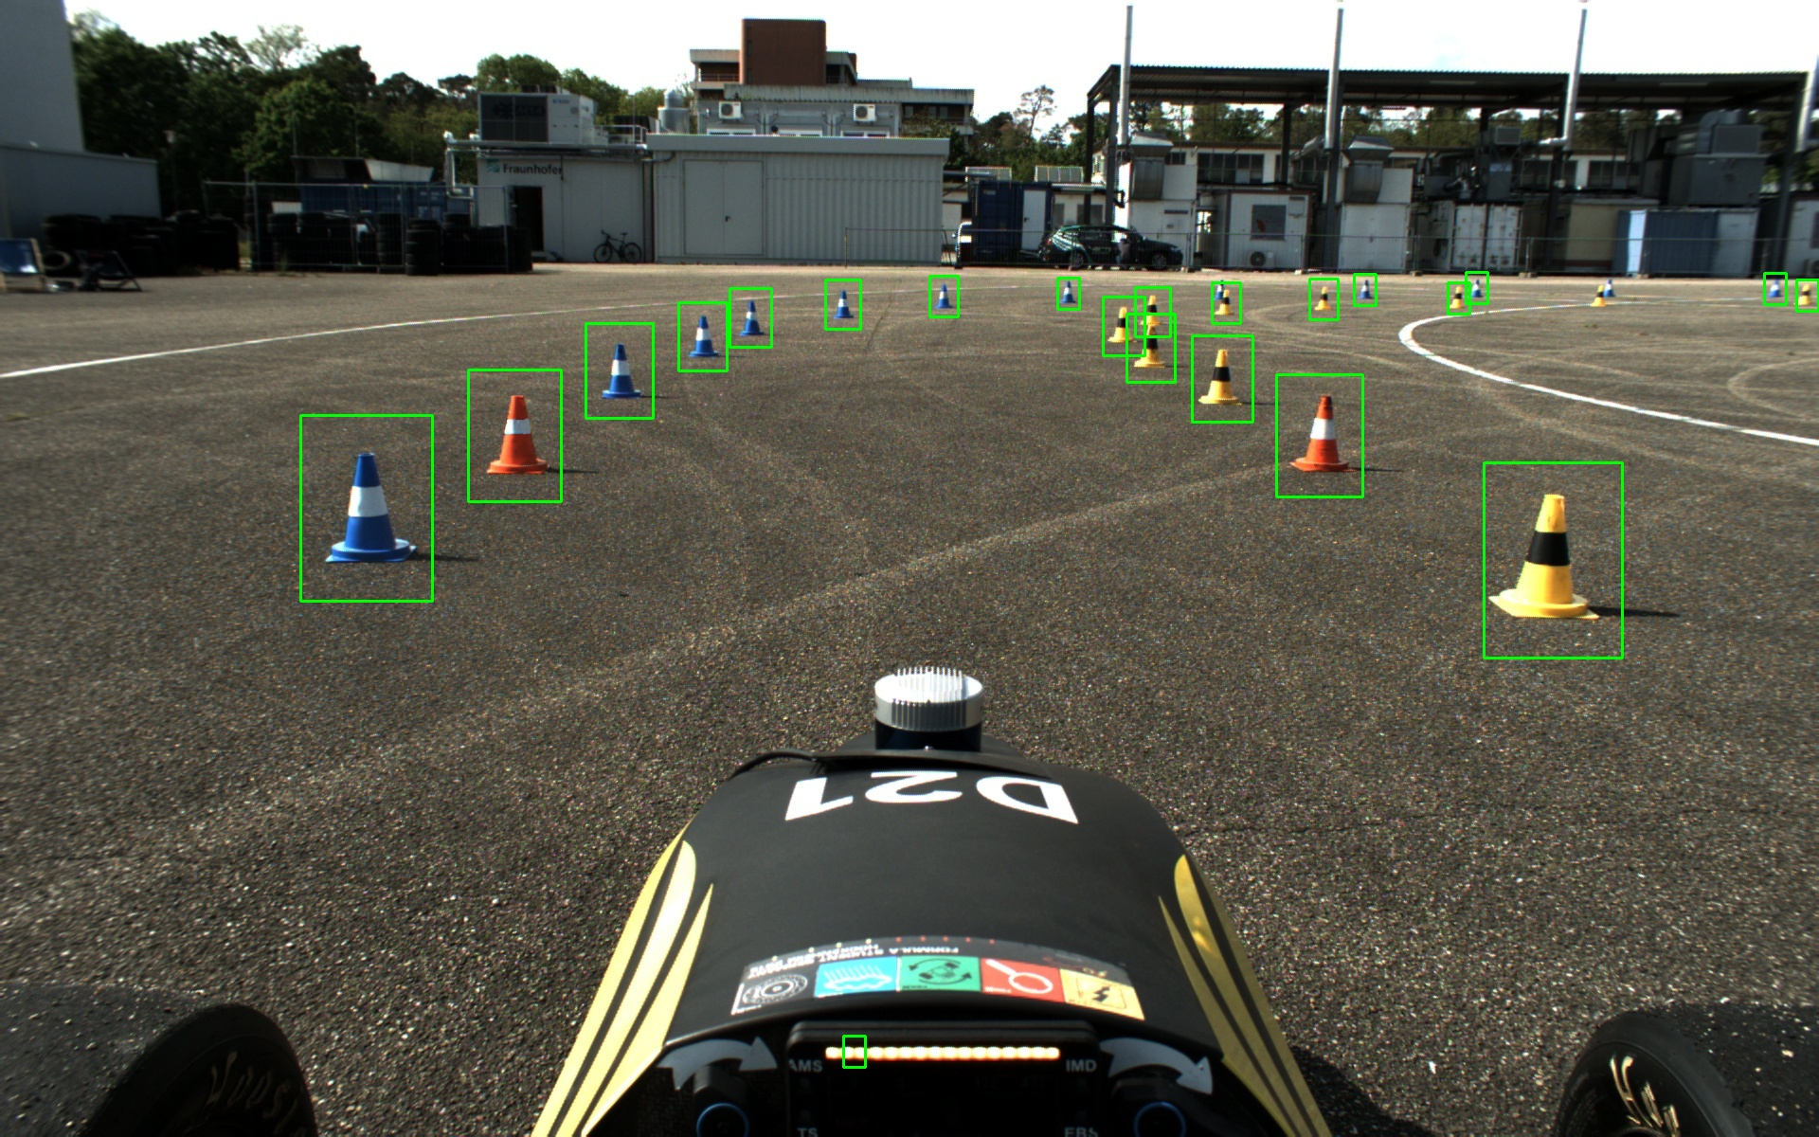
Implementation Methodologies
Filter False Positives (FFP): Eliminate detections that do not match expected cone dimensions. Minimum size (width > 20, height > 30) and an acceptable aspect ratio (between 0.5 and 2.0).(No. of cones = 22)
Sandipan
10

Slide 11
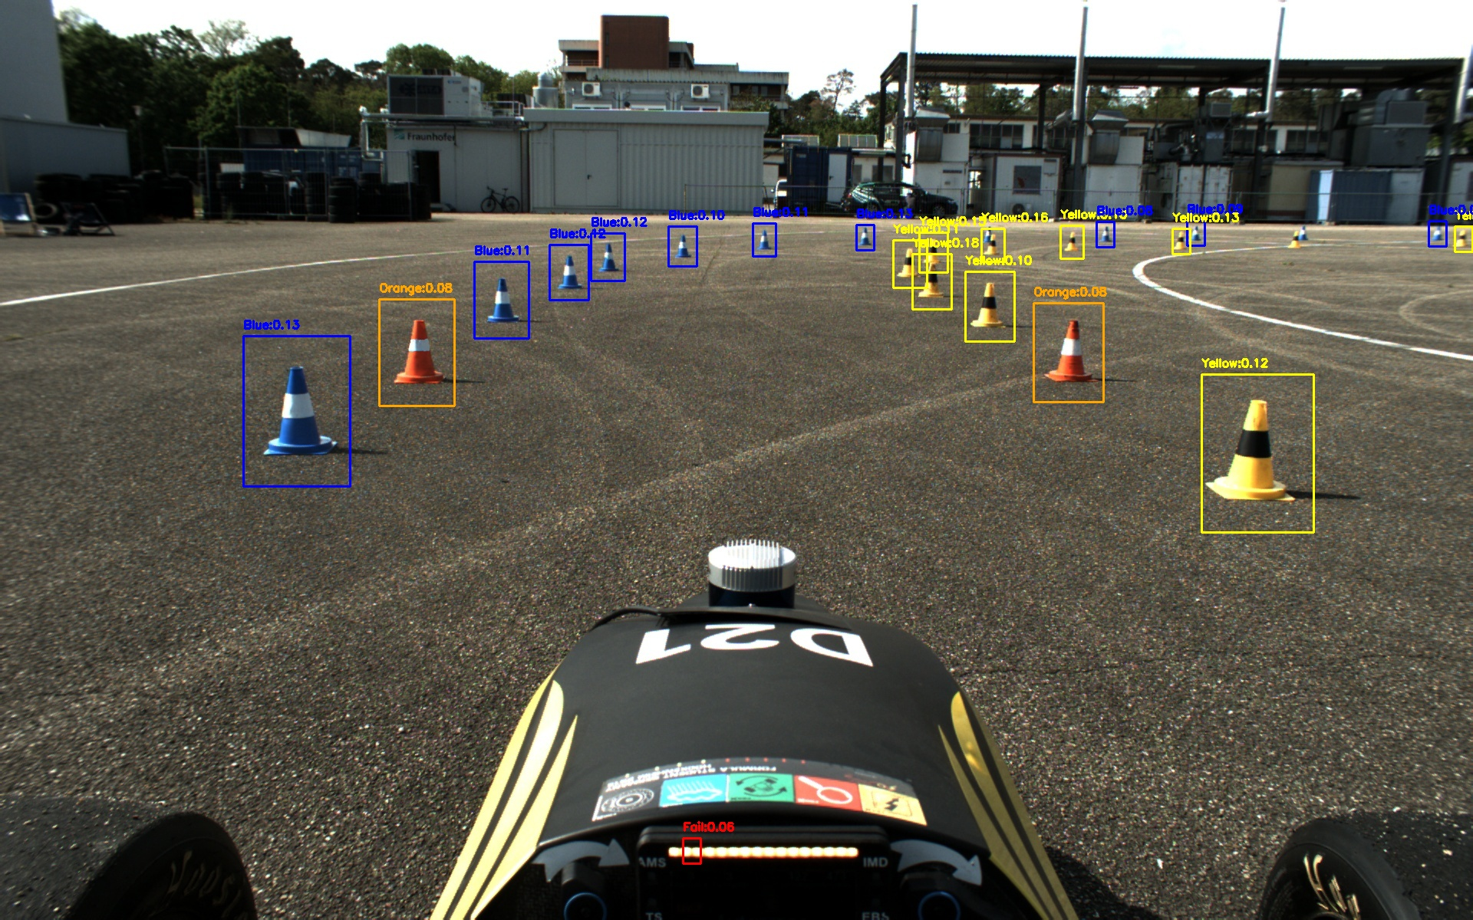
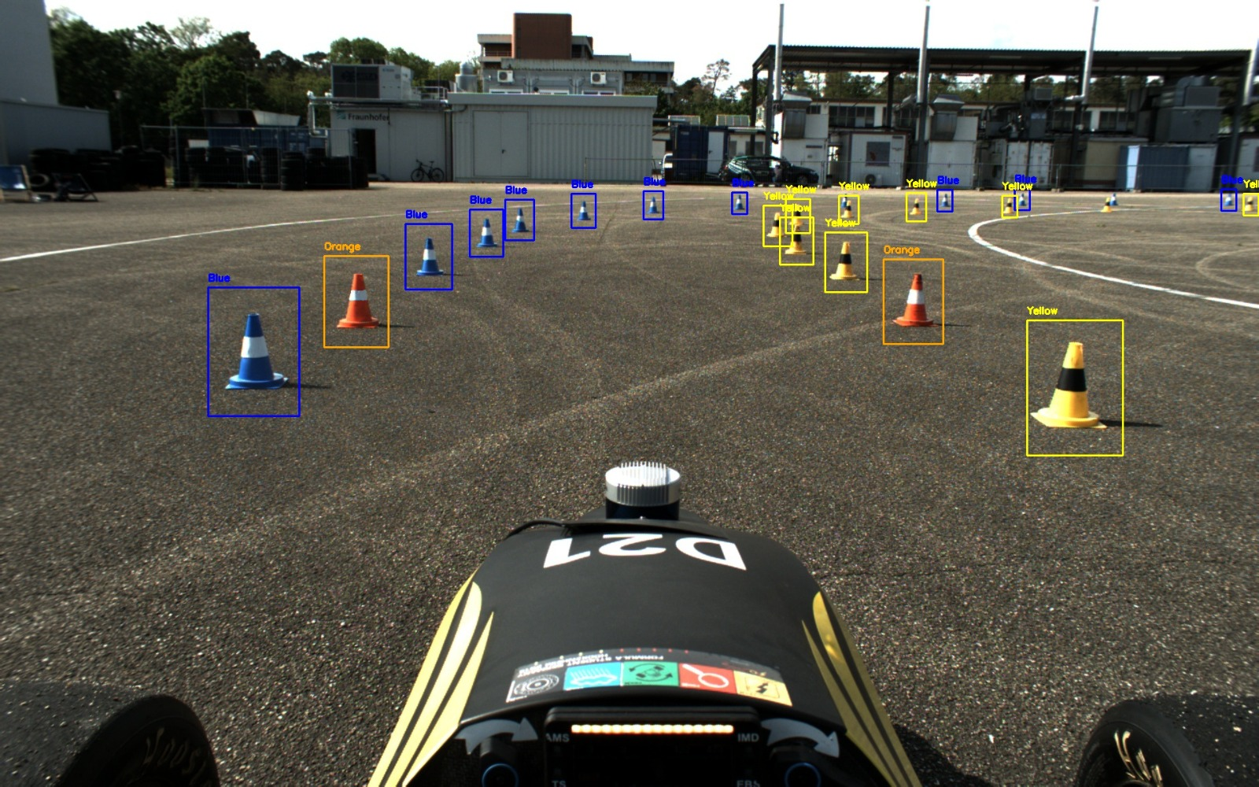
Implementation Methodologies
Coverage Threshold Check & Colour Labelling :
Colour Labelling and coverage threshold check
Skipping coverage below threshold 7%
Sandipan
11

Slide 12
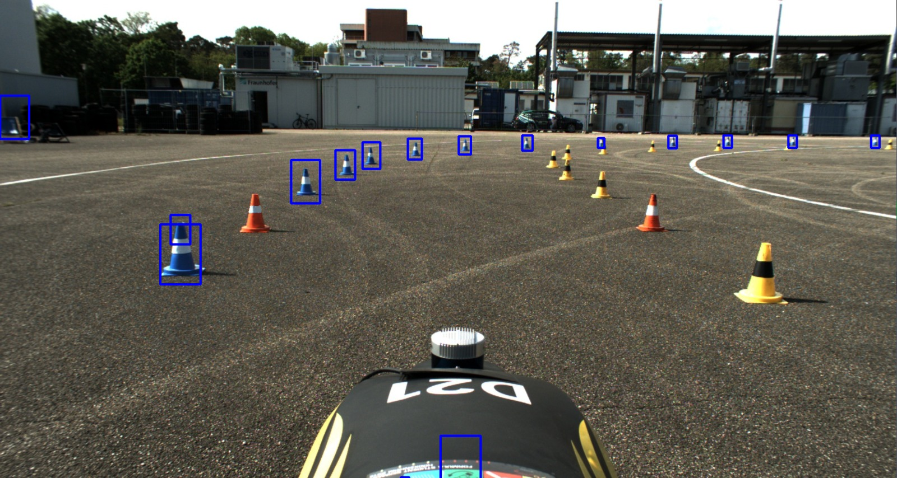
Results
Initial Implementation
GPU Enhancement
Sandipan
12

Slide 13
Results
Successfully integrated GPU acceleration alongside CPU-based processing.
Offloaded CPU, improving overall efficiency for real-time performance.
Improved accuracy in detection of cones
Removed all false detections
Built a scalable framework for future hardware acceleration enhancements.
Rizwan
13

Slide 14
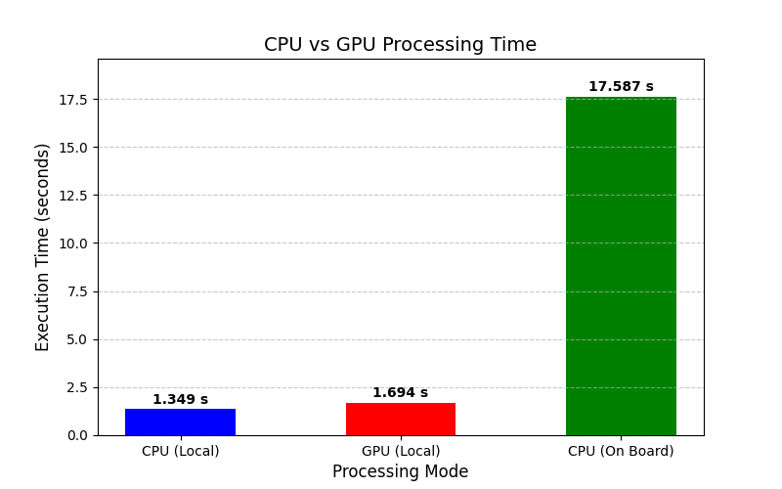
Results
Rizwan
14

Slide 15
Achievements
Processing Mode | Execution Time (seconds)
CPU ( Local) | 1.348579
GPU(Local) | 1.693663
CPU ( On Board) | 17.587154
Although GPU timing is slightly higher than CPU (Local), it successfully offloads the CPU by leveraging GPU acceleration.
90% of cones are detected accurately, with minimized false detections.
All colored cones are detected in one pass with proper color labeling for Blue, Orange, and Yellow.
Rizwan
15

Slide 16
Applications & Future Enhancements
Applications:
Autonomous vehicle perception.
Real-time racing scenarios.
Robotics and industrial automation.
Future Work:
Further optimize GPU utilization for speed gains and accuracy.
Explore detection for increased accuracy.
To outperform the performance of GPU, test the GPU implementation with parallel workloads.
Explore the hardware capabilities to overcome the present restrictions with the hardware accelerators.
Rizwan
16

Slide 17
Conclusion
The project successfully implemented GPU-based acceleration for cone detection
Offloaded the CPU
Improved the number of cones detected accurately
Efficient resource management improved system performance
A strong foundation is now set for future autonomous system enhancements
Rizwan
17

Slide 18
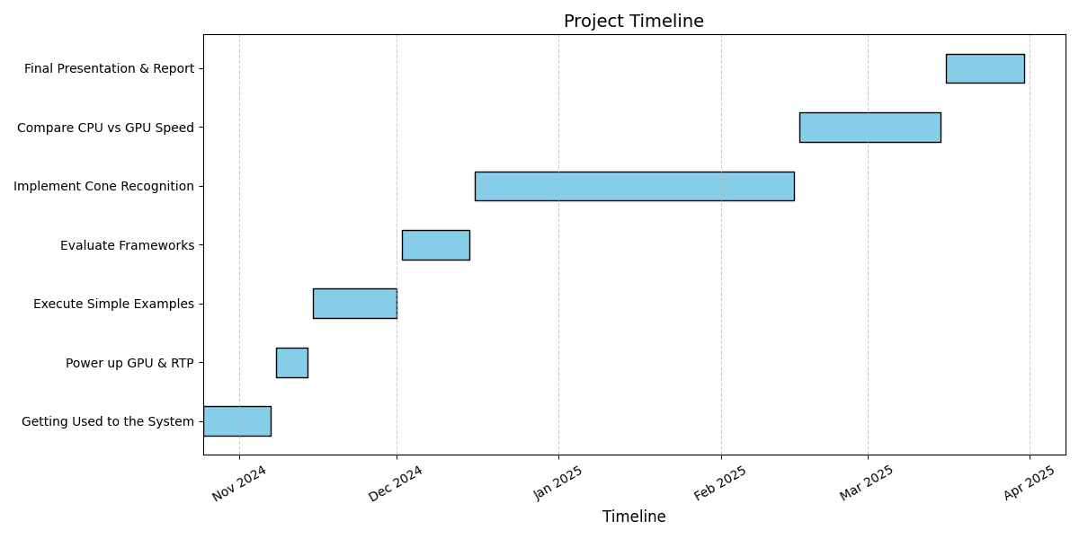
Timeline
Rizwan
18

Slide 19
Q&A
Thank You for your attention!
19

